Slide 1
Scrapy with MeetUp
Grant Webb
Data Science Project 2

Slide 2
Outline
Motivation
Webpage Overview
Questions / Answers from EDA

Slide 3
Motivation
I am an avid yogi and often look for yoga events and studios
The website Meetup.com provides an excellent platform for people of similar interests to meet and connect.
Yoga -> Sports and Fitness -> All Meetup Categories
Method used: Scrapy

Slide 4


Slide 5
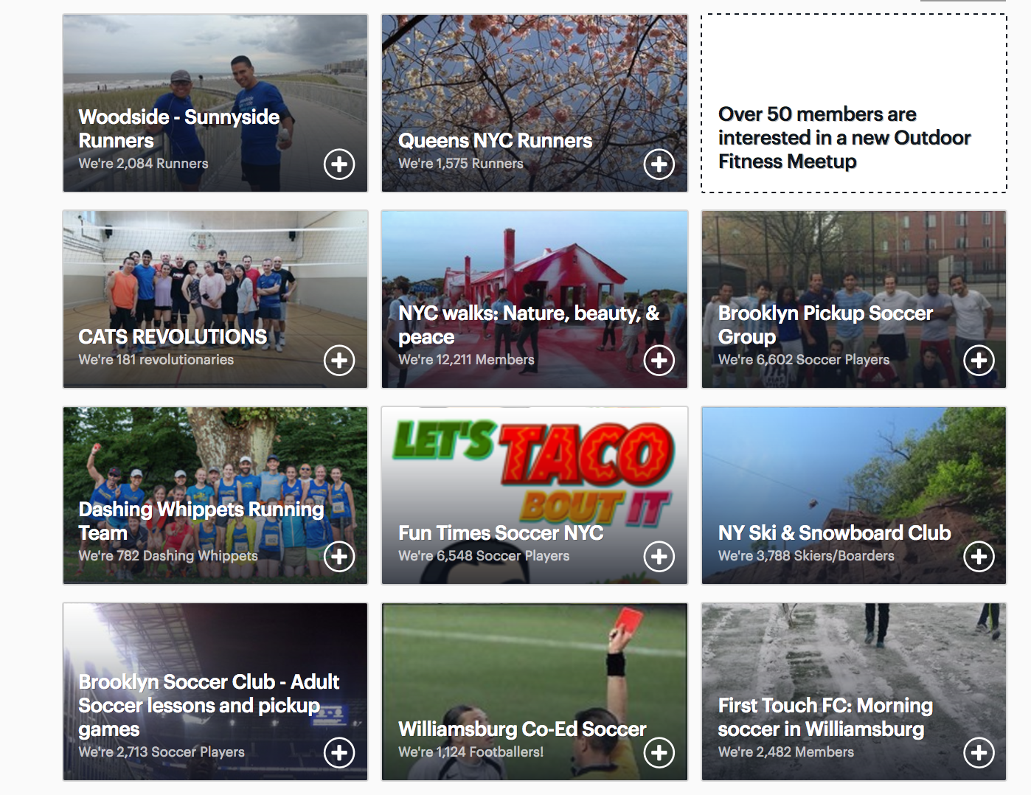

Slide 6
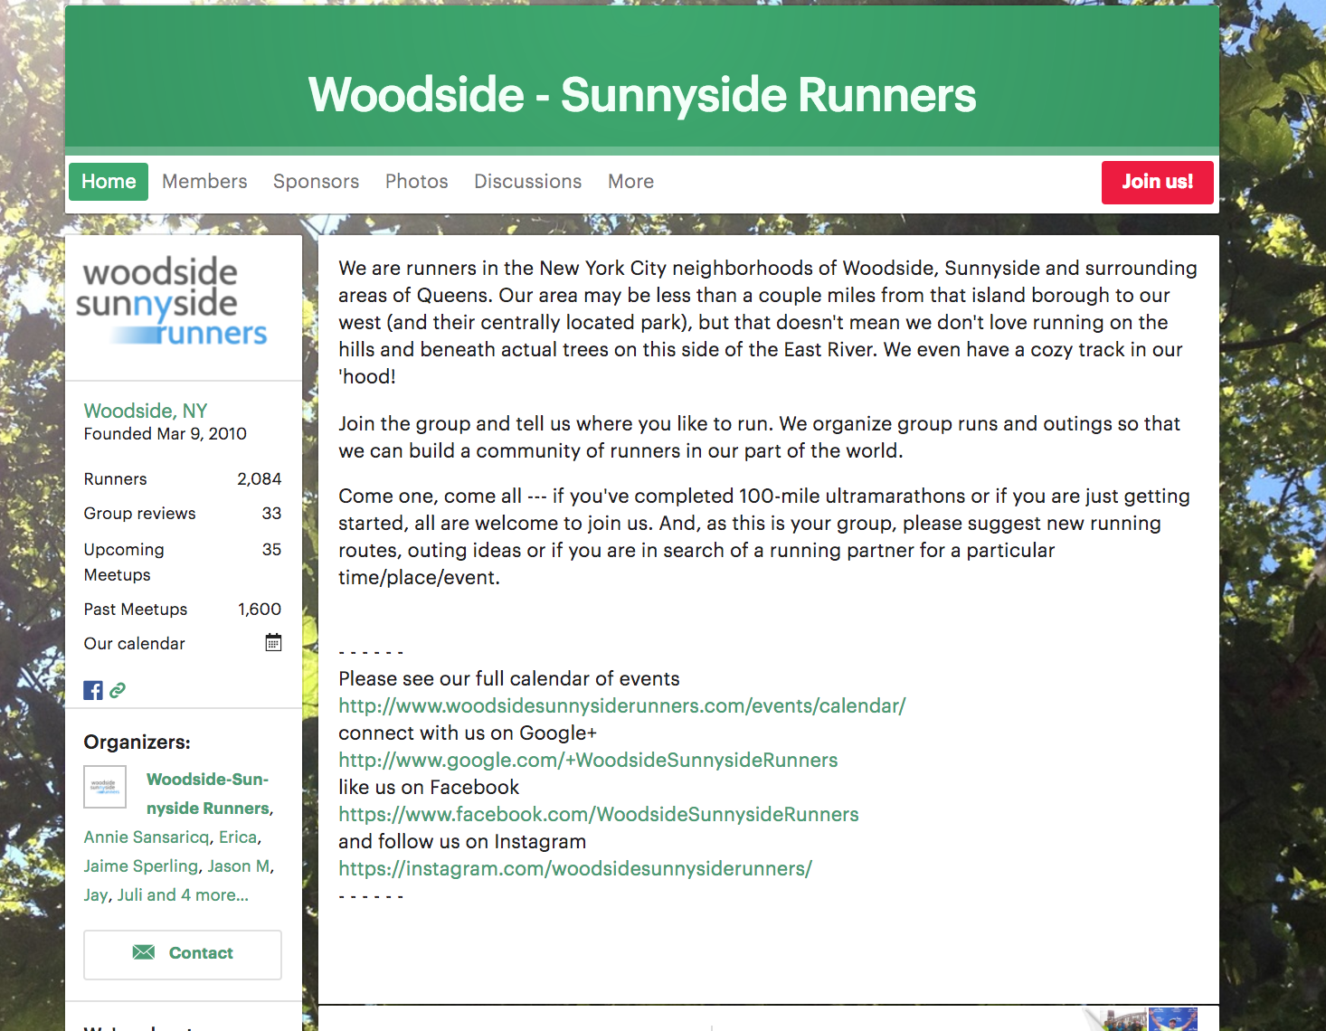
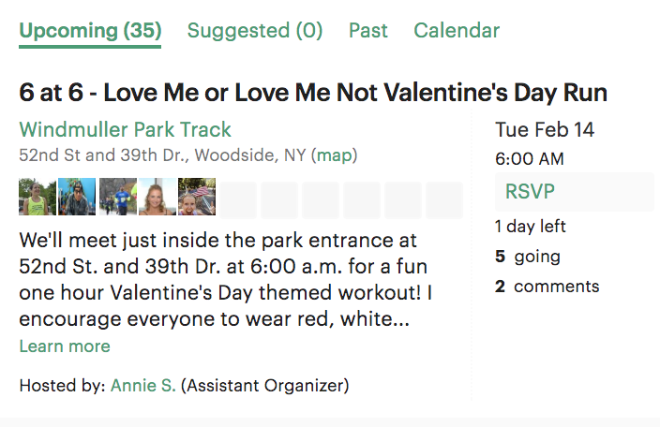

Slide 7
Data Scrapped
Category
Group Name
Group Members
Upcoming Meetings
Past Meetings
Group Reviews
Upcoming Meeting Date (Separated by Day and Date)
Upcoming Meeting Address
Upcoming Meeting Time

Slide 8
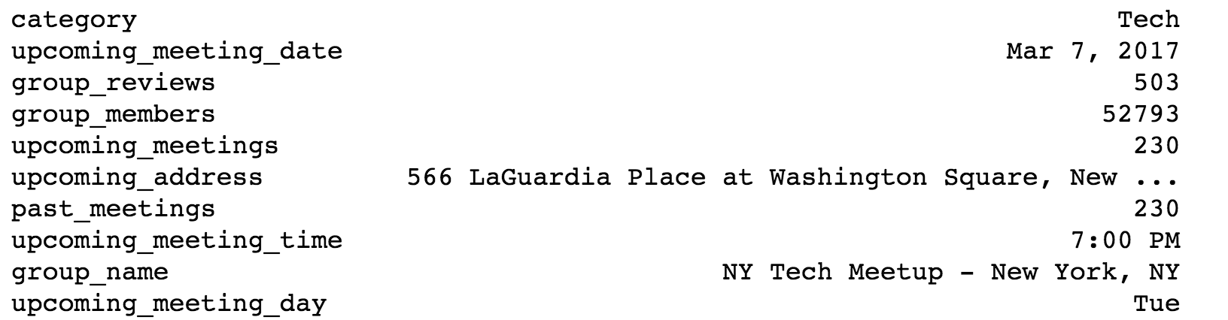
Questions / Answers
What is the most popular group in all of meetup?

Slide 9
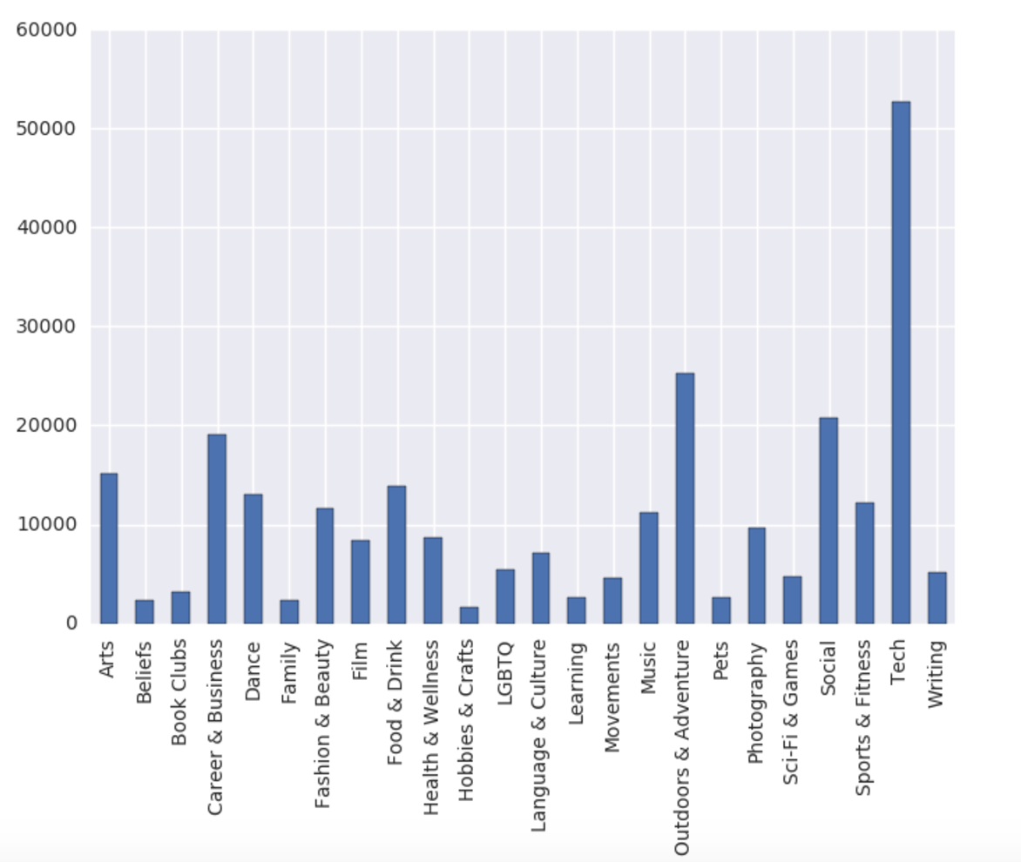
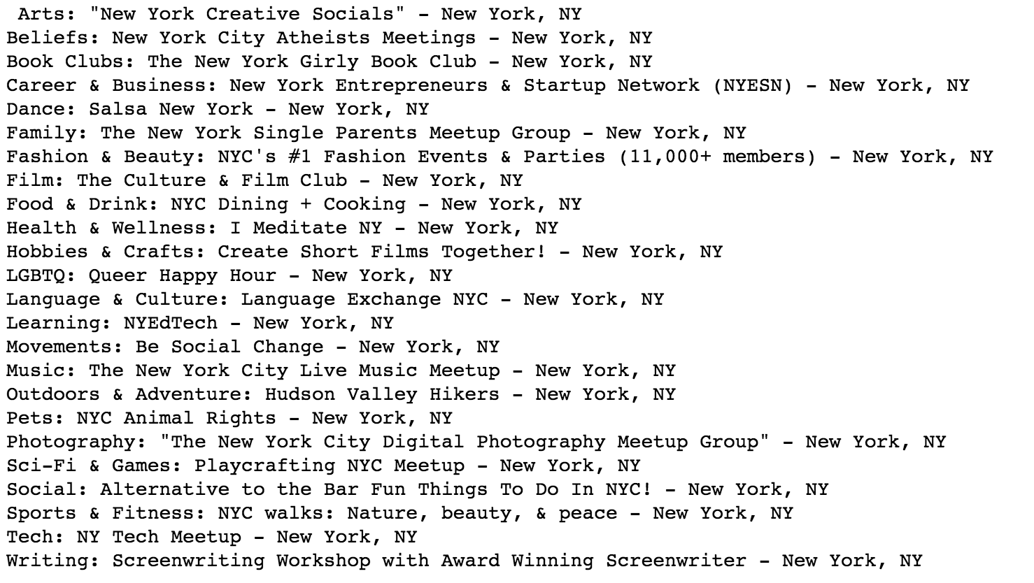
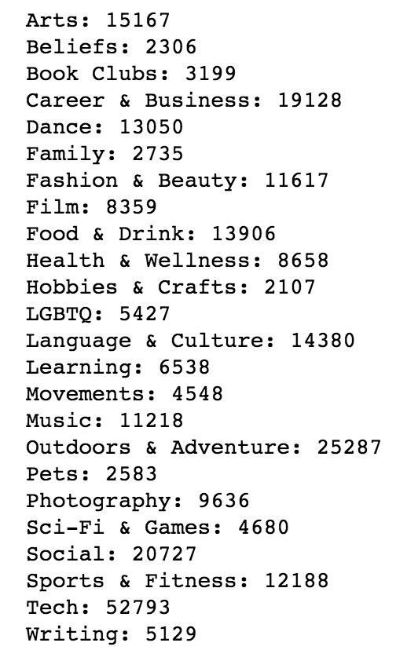
Questions / Answers
What is the most popular group in all of meetup for each category?

Slide 10
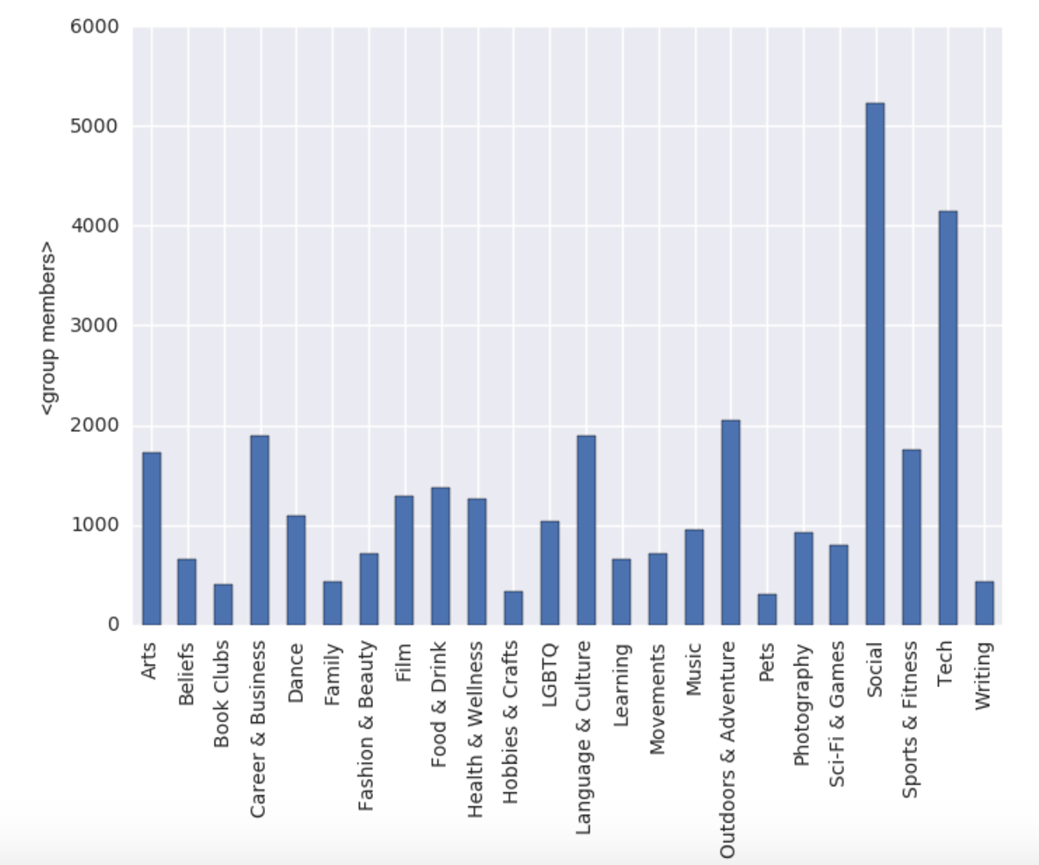
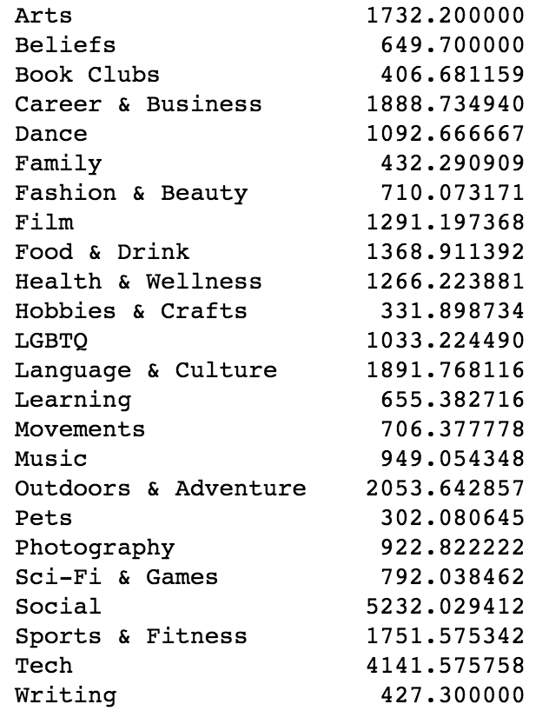
Questions / Answer
What is the average meetup group membership?
What is the average meetup group membership for each category?
1360

Slide 11
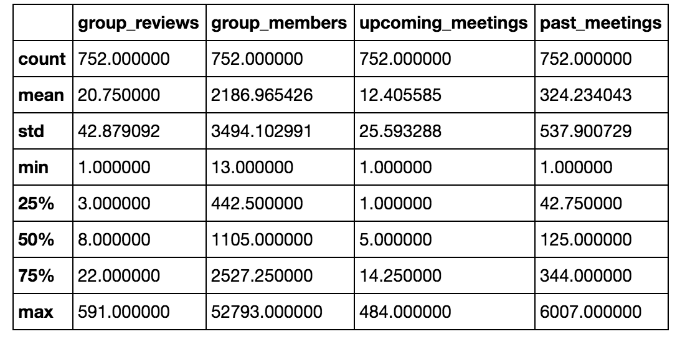
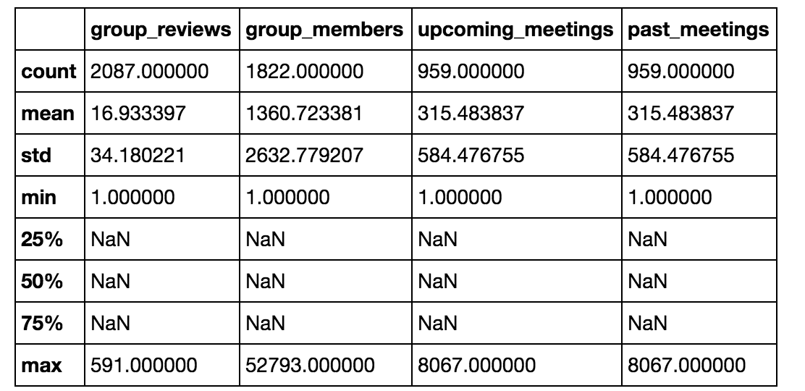
Wait, there’s a function for that!
Numbers Don’t Lie:
There’s A BUG!!!

Slide 12
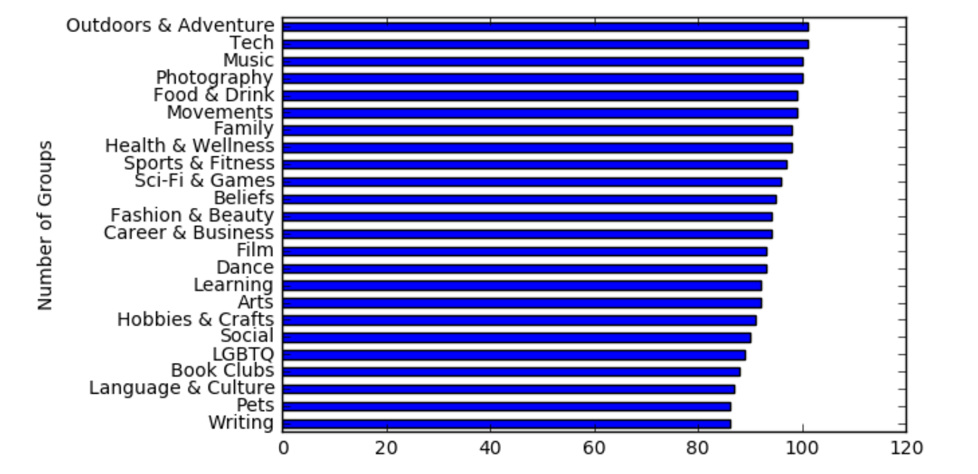
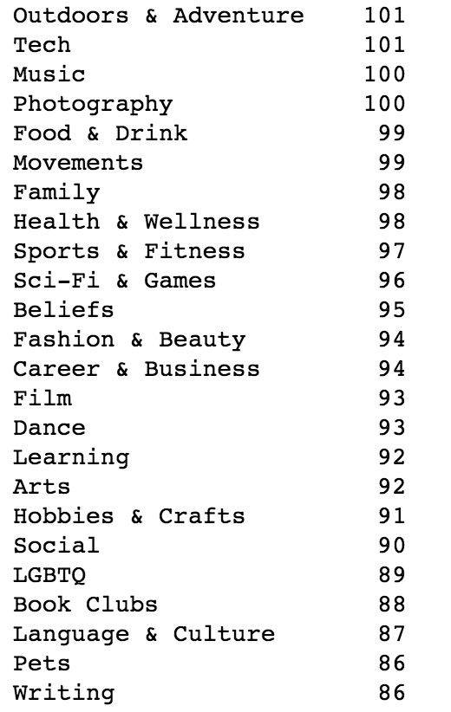
Questions / Answers
How many groups are there in each category?

Slide 13
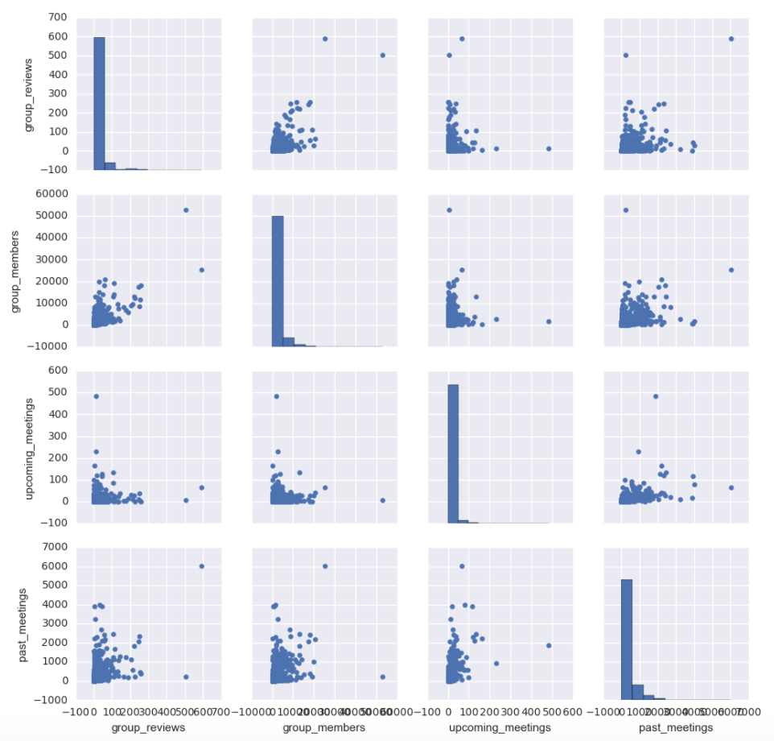
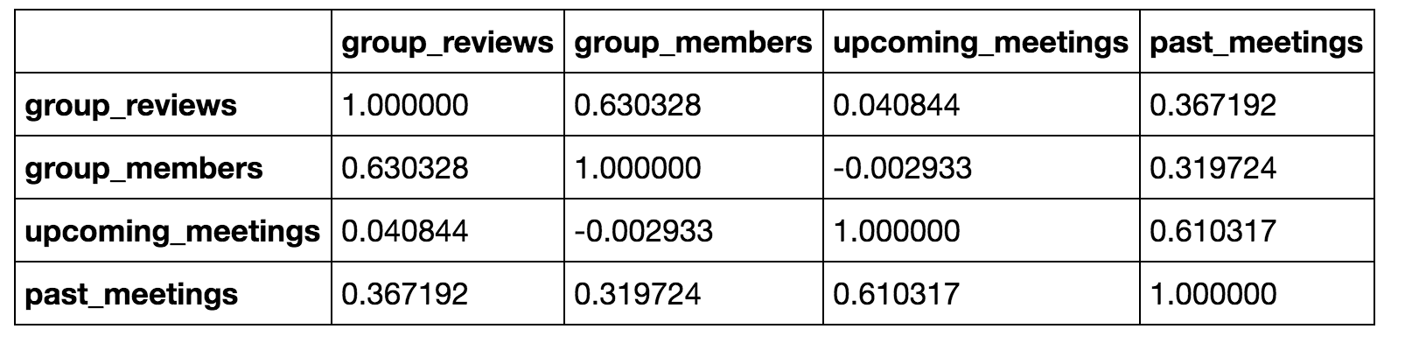
Questions / Answers
Is there a relationship between number of group members and past meetings, upcoming meetings, etc.?
Notes:
Orient x-axis labels Seaborn

Slide 14
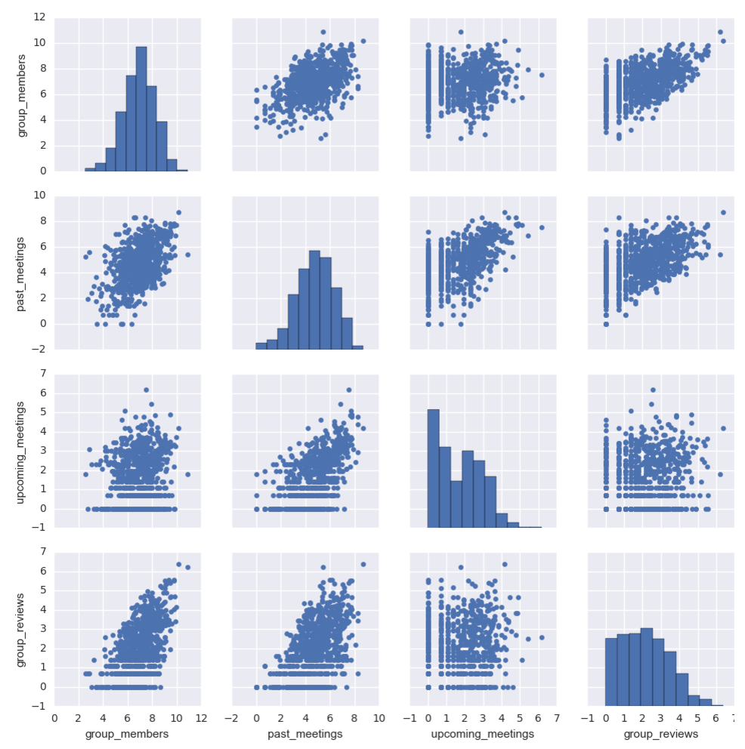
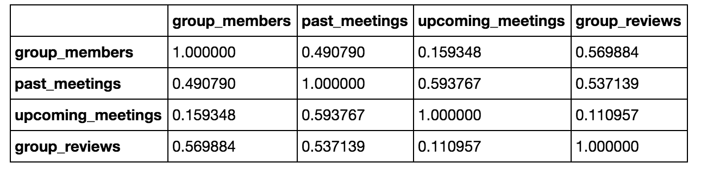
Log(it)

Slide 15
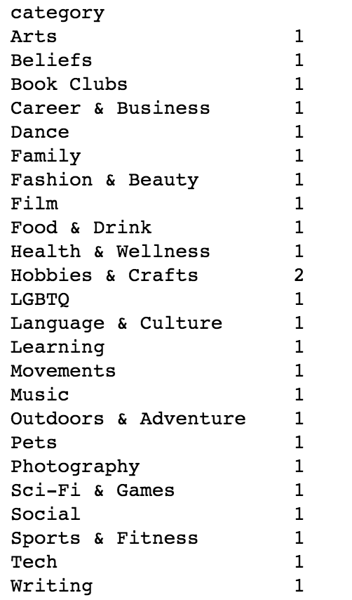
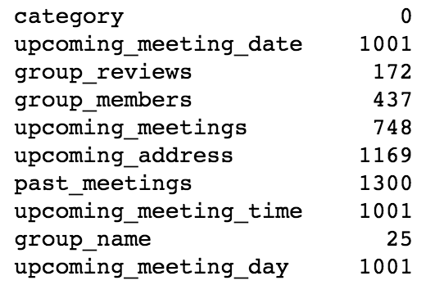
Question / Answer
Many groups have no information about them. How are many are there?
The number of missing values for each column

Slide 16
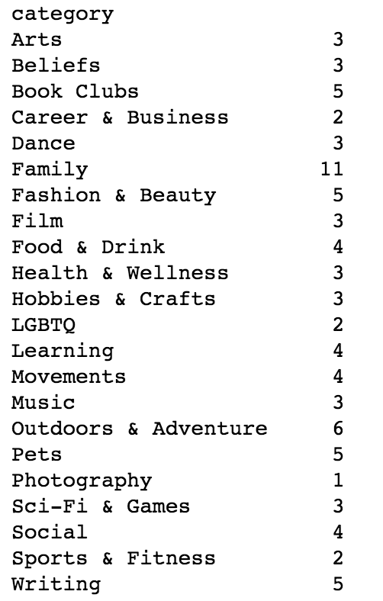

Question / Answer
Many groups have no information about them. How are many are there? And who are they?
Notes:
84

Slide 17
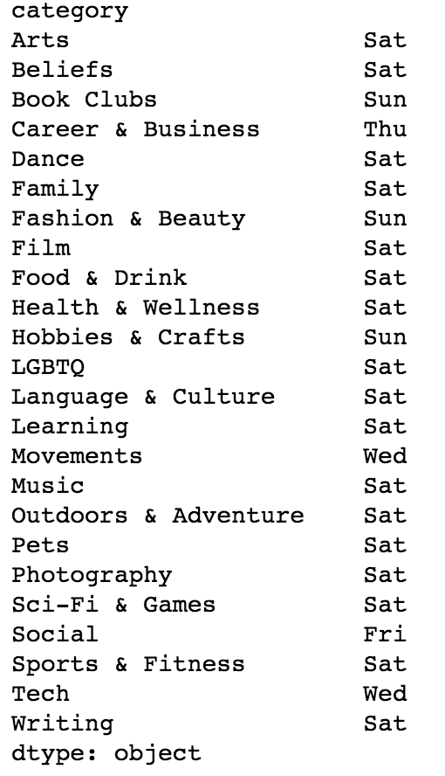
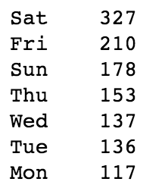
Question / Answer
What day of the week is most popular for upcoming meetup?

Slide 18
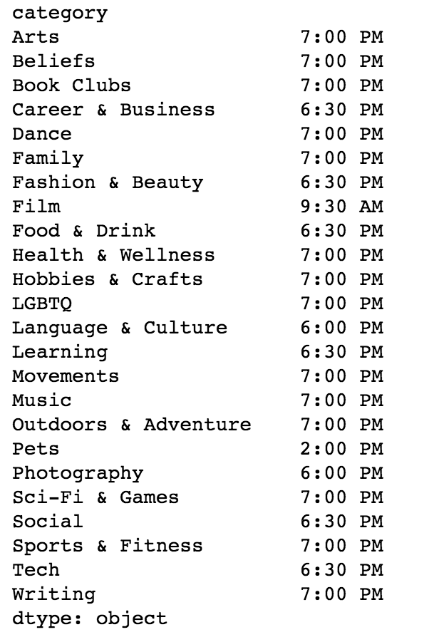
Question / Answer
What about time of the day?
1) 7:00 PM
2) 6:30 PM

Slide 19
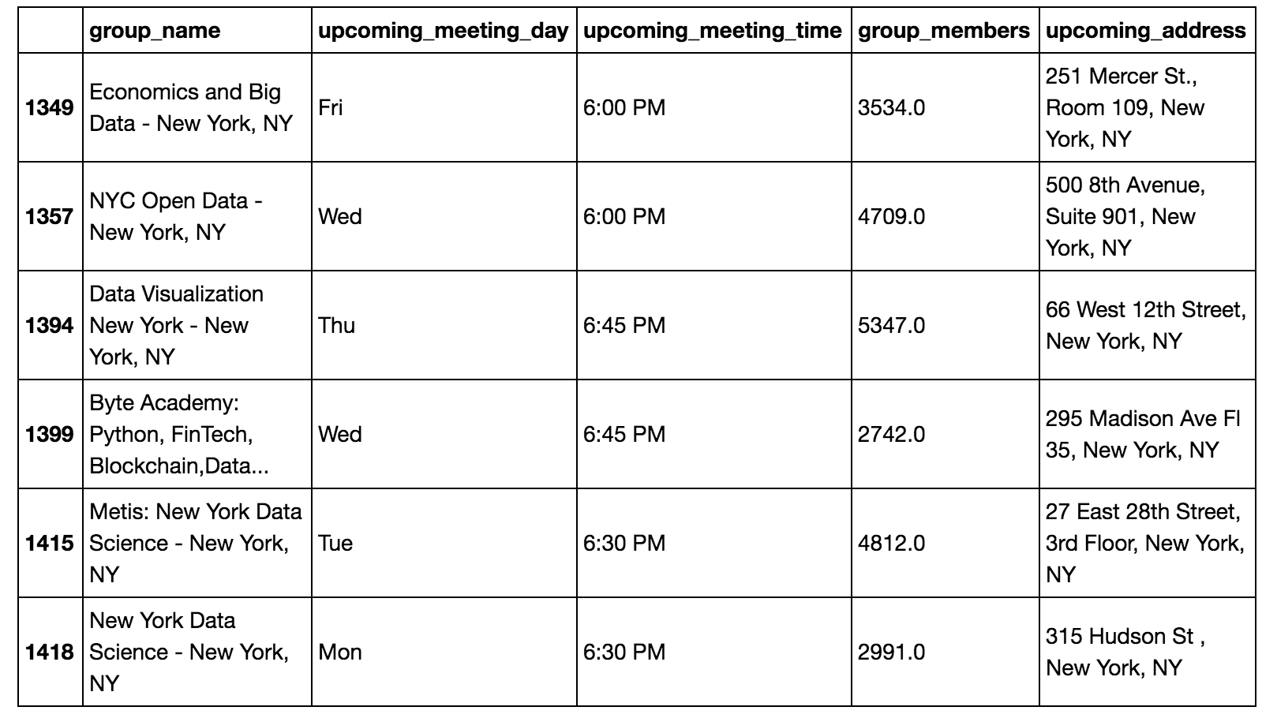
Question / Answer
How many groups are “Data” related?

Slide 20
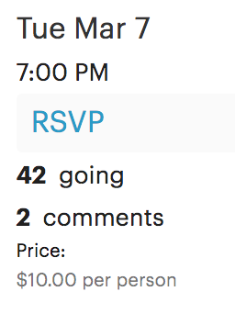

Further Work
Missed some interesting data to scrape
Expand the range from 5 miles to 10 miles
Look at top 5 populated cites
Look at meet-ups in some rural areas
Separate by geographical regions in the USA
Addresses: Map them out

